Slide 1
13
Chi-Square Tests

Slide 2
Chi-Square
So far, we’ve been working with normal distributions.
  What if it isn’t?
And with ratio scales.
  What if we’ve got counts (nominal)?

Slide 3
Chi-Square Tests
Hypothesis testing procedures for nominal variables (variables whose values are categories)
Focus on the number of people in different categories

Slide 4
Chi-Square
Goodness of fit – how well an observed frequency distribution of a nominal variable fits some expected frequency pattern.
Test for independence – tests to see if distribution of frequencies of one variable is related to the distribution of another variable.
Notes:
Two types of chi-square test
…..goodness of fit is for one row of data
…..independence is for two rows of data

Slide 5
Goodness of Fit Tests
Null – you expect all the frequencies to be equal to expected frequencies
Res – you expect the observed frequency to be different from the expected frequency
Notes:
So basically we would say expected = observed = ho
Expected not = observed = ha

Slide 6
Chi-Square Statistic -1
Key idea is the comparison of observed and expected frequencies in each category
Observed frequency
  # of people actually found in the study to be in a category or cell
Expected frequency
  # of people in the category expected if the null hypothesis were true

Slide 7
Hypothesis Testing
2 Determine comparison distribution
  Nominal variables chart
  Degrees of Freedom
Df = N categories – 1
  Or number of columns minus 1

Slide 8
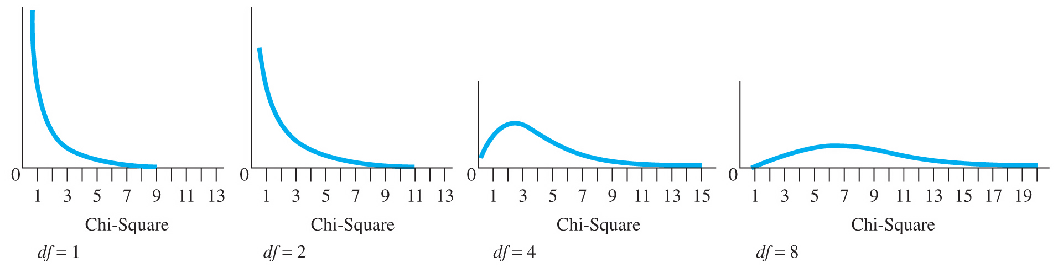
Chi-Square Statistic
Chi-square distribution
Copyright © 2009 Pearson Education, Inc. Upper Saddle River, NJ 07458. All rights reserved.

Slide 9
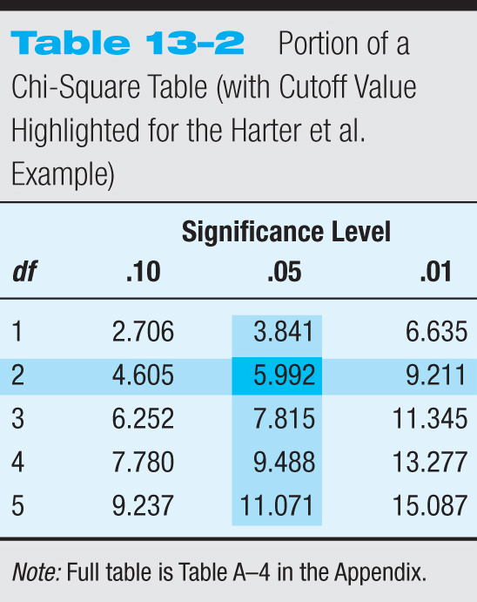
Hypothesis Testing
3 Cutoff statistic
  Look this up in the
  chi-square table!
Notes:
They have this chi-square table – it’s on the back of the f-distribution/t-distribution they already have. Make them look at it and find critical values for example.

Slide 10
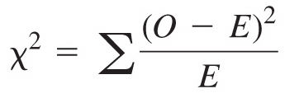
The Chi-Square Test for Goodness of Fit
Levels of a single nominal variable
Copyright © 2009 Pearson Education, Inc. Upper Saddle River, NJ 07458. All rights reserved.

Slide 11
Hypothesis Testing
5 Decide if you should reject
  Chi-square is also one tailed (similar to F)
  So step 4 > step 3.
Notes:
After this slide go over how to get step 4 – the actual math part

Slide 12
Hypothesis Testing
If you reject:
  The categories do not have the expected values in the columns
If you fail to reject:
  The categories do have the same expected values in the columns.

Slide 13
Dice Example
How many times would you expect to get each roll of the die?
  (expected value)
Get the observed value
Find Chi-square

Slide 14
Chi-Square Test for Independence -1
Two nominal variables, each with several categories
Contingency table

Slide 15
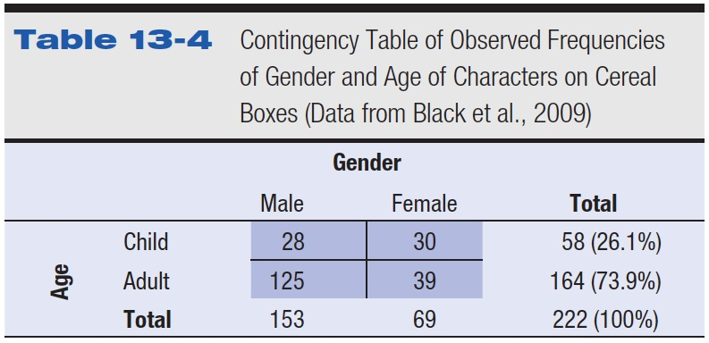
Table 13-4 Contingency Table of Observed Frequencies of Gender and Age of Characters on Cereal Boxes (Data from Black et al., 2009)

Slide 16
Chi-Square Test for Independence -2
Independence
  No relationship exists between the variables in a contingency table
Sample and population

Slide 17
Hypothesis Testing
Null: rows and columns are unrelated
Res: rows and columns are related

Slide 18

Hypothesis Testing
Comparison distribution
  Df
  Independence table

Slide 19
Hypothesis Testing
Cut off score:
  Use DF and Chi square table.

Slide 20
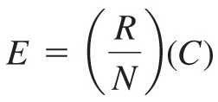
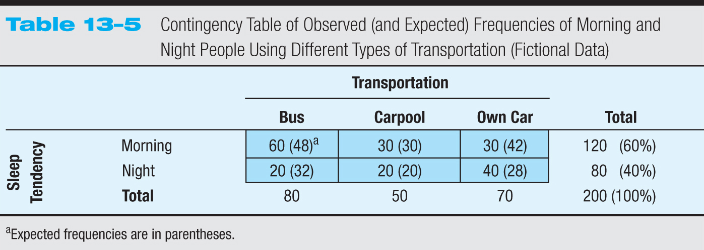
The Chi-Square Test for Independence
Determining expected frequencies
Copyright © 2009 Pearson Education, Inc. Upper Saddle River, NJ 07458. All rights reserved.

Slide 21
The Chi-Square Test for Independence
Step 4
Copyright © 2009 Pearson Education, Inc. Upper Saddle River, NJ 07458. All rights reserved.

Slide 22
Hypothesis Testing
Step 5 – is step 4 > step 3?
  If yes: reject – there is a relationship between rows and columns
    In other words, you need to know both pieces of information to correctly classify someone. OR That values are not the same across the variables.
  If no: fail to reject – there is not a relationship between rows and columns
    Or that the two show the same pattern of values.

Slide 23
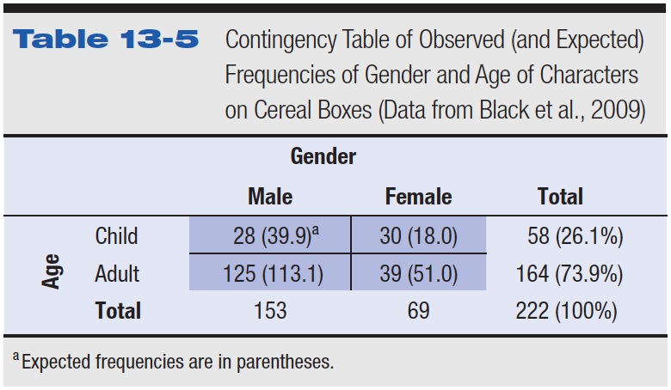
Table 13-5 Contingency Table of Observed (and Expected) Frequencies of Gender and Age of Characters on Cereal Boxes (Data from Black et al., 2009)

Slide 24
Assumptions for Chi-Square Tests
No individual can be counted in more than one category or cell

Slide 25
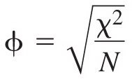
Effect Size for the Chi-Square Test for Independence -1
2 X 2 contingency table
  Phi coefficient (φ)
  small φ = .10
  medium φ = .30
  large φ = .50

Slide 26
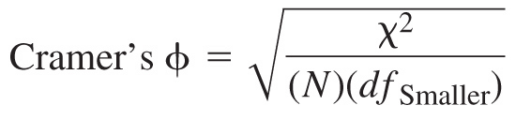
Effect Size for the Chi-Square Test for Independence -2
Contingency tables larger than 2 × 2
  Cramer’s phi

Slide 27
Effect Size for the Chi-Square Test for Independence -3
Effect size for Cramer’s phi

Slide 28
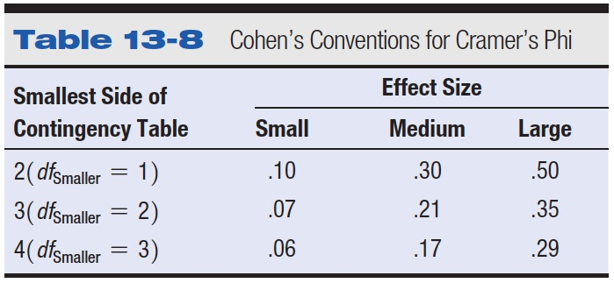
Table 13-8 Cohen’s Conventions for Cramer’s Phi

Slide 29
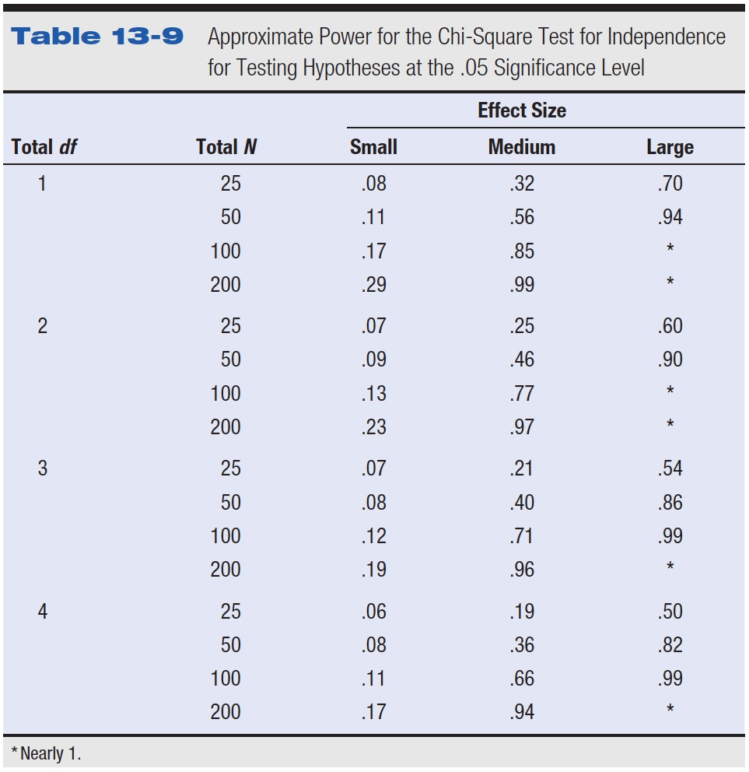
Table 13-9 Approximate Power for the Chi-Square Test for Independence for Testing Hypotheses at the .05 Significance Level

Slide 30
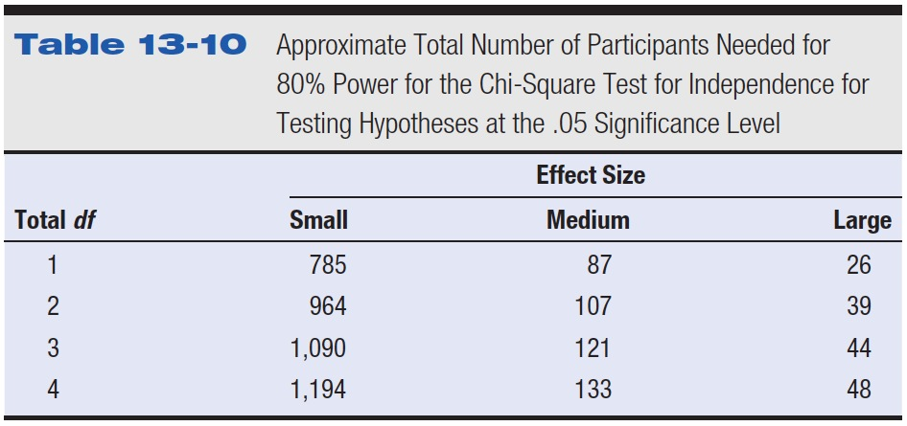
Table 13-10 Approximate Total Number of Participants Needed for 80% Power for the Chi-Square Test for Independence for Testing Hypotheses at the .05 Significance Level

Slide 31
Controversies and Limitations
Minimum acceptable frequency for a category or cell
Small expected frequencies
  At least 5 times as many individuals as categories (or cells)
  Reduce power

Slide 32
Chi-Square Tests in Research Articles
χ²(2, n = 101) = 11.89, p < .005

Slide 33
A study of the effects of lack of REM sleep on the ability to recall a list of words found that of participants who did not get normal REM sleep, 4 scored high on memory recall, 7 scored moderately, and 9 scored low. Of participants who got normal sleep, 10 scored high, 9 moderately, and 1 low. Using the .01 significance level, is REM sleep related to how people score on the memory recall task?
a. Use the five steps of hypothesis testing using p<.05.

Slide 34
A researcher wanted to know how many people were likely to go to the voting polls if voting was moved to a Saturday. He got the following information:
Yes 125
No 80
Maybe 55
Did he get the equal responses for all three answers? Write out the five hypothesis testing steps, using p<.01.

Slide 35
In a certain town, there are about one million eligible voters. A simple random sample of 10000 eligible voters was chosen to study the relationship between sex and participation in the last election. The results are summarized in the following 2X2 (read two by two) contingency table, using p<.05:
Men Women
Voted 2792 3591
Didn't vote 1486 2131

